Slide 1
Generating fake human faces using GAN
presented by
INNISA.S
Reg.No:950021104015

Slide 2
PROJECT TITLE:
Generating fake human faces using GAN

Slide 3
AGENDA:
INTRODUCTION
WORKING OF GANs
PROBLEM STATEMENT
PROJECT OVERVIEW
END USERS
MY SOLUTION AND IT’S VALUE PROPORTION
THE WOW IN MY SOLUTION
MODELING
RESULT

Slide 4
INTRODUCTION:
Generative Adversarial Networks (GANs) are generative models. They are uses unsupervised technique to generate new things.
GAN models learns pattern in input data in such a way that they can generate new sample which resemble with the input data.
The main aim of generative adversarial network is to match generated distribution with the original data distribution.

Slide 5
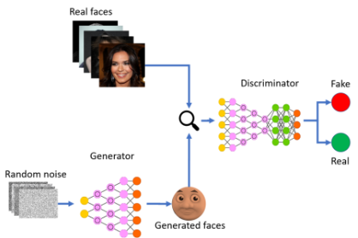
INTRODUCTION
GANs are an exciting and rapidly changing field, delivering generative models ability to generate realistic examples across a range of problem domains, most notably in image-to-image translation tasks such as translating photos of summer to winter or day to night,coloring images and in generating fake photos that even human cannot categorized as fake image.

Slide 6
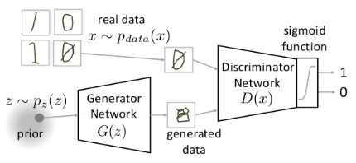
WORKING OF GANs:
First of all we take batch of random vector from the Gaussian distribution and generate fake image out of it using generator.
Since generator isn't trained so generated image do not resemble with the real input distribution.
We take batches of image from the input distribution along with generated fake images and fed it to discriminator so that it learns to distinguish between real and fake images

Slide 7
PROBLEM STATEMENT:
Design a Generative Adversarial Network (GAN) capable of creating synthetic human faces. The GAN should be trained on a dataset of real human faces and generate high-resolution, photorealistic images that resemble genuine faces. Evaluate the performance of the GAN based on metrics like image quality, diversity of generated faces, and realism. Consider computational efficiency and scalability for real-time applications.

Slide 8
PROJECT OVERVIEW:
Objective: To develop a Generative Adversarial Network (GAN) capable of generating synthetic human faces.
Dataset Acquisition: Collect a diverse dataset of real human faces to train the GAN.
GAN Architecture: Design and implement a GAN architecture consisting of a generator and a discriminator.
Training Process: Train the GAN on the dataset to learn the distribution of real faces and generate fake faces.
Evaluation Metrics: Assess the performance of the GAN based on image quality, diversity of generated faces, and realism.
Optimization: Fine-tune the GAN architecture and training process to improve results.
Documentation: Record the training process, architecture details, and evaluation results for future reference.

Slide 9
END USERS:
Content Creators:
Social media influencers, bloggers, and YouTubers looking for unique profile pictures and content visuals.
Game Developers:
Incorporating diverse character designs and NPCs into video games for enhanced gameplay experiences.
Artists and Designers:
Using generated faces as references or elements in digital artworks, illustrations, and graphic designs.
Researchers and Academics:
Studying facial recognition, computer vision, and generative modeling techniques for academic research and publications.
Privacy Advocates:
Advocating for privacy by using fake faces to anonymize images and protect individual identities in public datasets.
Educators:
Teaching about AI, machine learning, and generative modeling by demonstrating the process of generating fake faces.

Slide 10
MY SOLUTION AND IT’S VALUE PROPORTION:
Solution: Utilizing a Generative Adversarial Network (GAN) to generate synthetic human faces by training on a dataset of real faces.
VALUE PROPORTION:
Versatile Content Creation: Empowers content creators, game developers, and designers with a tool to quickly generate diverse and photorealistic faces for their projects, saving time and resources.
Privacy Preservation: Offers a solution for anonymizing images in public datasets or protecting individuals' identities in sensitive applications, enhancing privacy protection measures.
Inclusive Representation: Facilitates the creation of inclusive content by generating faces representing diverse ethnicities, ages, and genders, fostering representation and diversity in digital media.
Ethical Training Data: Provides researchers and developers with a means to generate synthetic training data for facial recognition systems, reducing reliance on potentially biased or privacy-compromising real data.
Educational Resource: Serves as an educational tool for teaching about AI, machine learning, and generative modeling, fostering understanding and innovation in these fields.
Artistic Exploration: Inspires artists and designers to explore new creative avenues by incorporating synthetic faces into digital artworks and designs, encouraging artistic experimentation and expression.

Slide 11
THE WOW IN MY SOLUTION:
GANs, or Generative Adversarial Networks, are AI systems composed of two neural networks: a generator and a discriminator.
The generator learns to create fake faces resembling real ones, while the discriminator evaluates their authenticity.
This adversarial process results in the generator producing increasingly realistic fake faces.
Value Proposition: Offers an efficient and innovative method for generating diverse and lifelike faces.
Applications span across entertainment, research, and privacy protection.
Benefits include saving time and resources, promoting ethical data use, and fostering creative freedom.

Slide 12
MODELING:
GAN, short for Generative Adversarial Network, consists of two main components: a generator and a discriminator.
The generator network takes random noise as input and generates synthetic images, in this case, fake faces.
The discriminator network receives both real and fake images and learns to distinguish between them.
During training, the generator aims to produce increasingly realistic fake faces that can fool the discriminator.
This adversarial process encourages the generator to learn the underlying distribution of real faces and generate high-quality fakes.
Through iterative training, the generator improves its ability to produce convincing fake faces, ultimately creating diverse and realistic outputs.

Slide 13
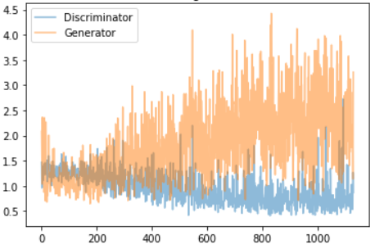
TRAINING LOSS:

Slide 14
DATASET LINK:
https://www.kaggle.com/datasets/prasoonkottarathil/face-mask-lite-dataset

Slide 15
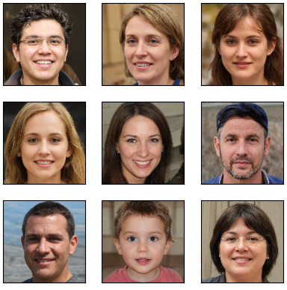
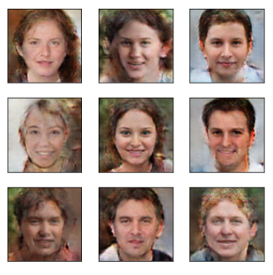
RESULT:
ORIGINAL HUMAN FACE IMAGE
FAKE HUMAN FACE IMAGE

Slide 16
thank you

